Slide 1
Azure Integration Services
SoCal Azure User Group
September 10th, 2019

Slide 2

Thank you,

Slide 3

About Me
{
“name”: “David Barkol”,
“title”: “Azure Architect at Microsoft – Global Black Belt (GBB) team”,
“location”: “Southern California”,
“twitter”: “@dbarkol”,
“email”: “dabarkol@microsoft.com”,
“github”: “https://github.com/dbarkol,
“blog”: “https://madeofstrings.com”
}

Slide 4
Agenda
Integration in Azure
The value of APIs
Messaging and Events
Orchestration and Workflows
https://aka.ms/socalazure-integration

Slide 5

Integration scenarios
Application to Application
Business to Business
SaaS
IoT
Notes:
The architecture of applications

Slide 6
Integration challenges
Interfaces and APIs
Data sources and formats
Service-oriented and distributed
On-premises or cloud

Slide 7






Azure Integration Services
Customers
Partners
Employees
Power BI
PowerApps
Microsoft Flow
Visual Studio
Messaging
APIs
Orchestration
Service Bus
Event Grid
API Management
Logic Apps
SaaS
Packaged Applications
Custom Applications
Data

Slide 8




Azure Integration Services
iPaaS
Serverless
Multiple personas
Azure Integration Services
Time to Market
Micro billing
Rapid development
Focus on
business logic
Reduce costs
Pay per
action
Approachable
Reduced DevOps
Low/No-code
Templates
API-centric
Event driven
scale
Abstraction
of servers
Notes:
Intersection of these two worlds

Slide 9




APIs
Workflows
Messages
Events

Slide 10
API Management
Logic Apps
Service Bus
Event Grid

Slide 11
Azure Integration Services

Slide 12


API Management
Front-end service that encapsulates backend services
Exposes single point of entry
Routes requests to backend service
Fans requests across multiple services
Insulates client from internal refactoring
Beware of ”overly-ambitious” gateways

Slide 14
Gateway Pattern
Routing
Authentication
Logging
Caching
Retry/Circuit breaker
Throttling
SSL termination

Slide 15
Demo: API Management

Slide 16




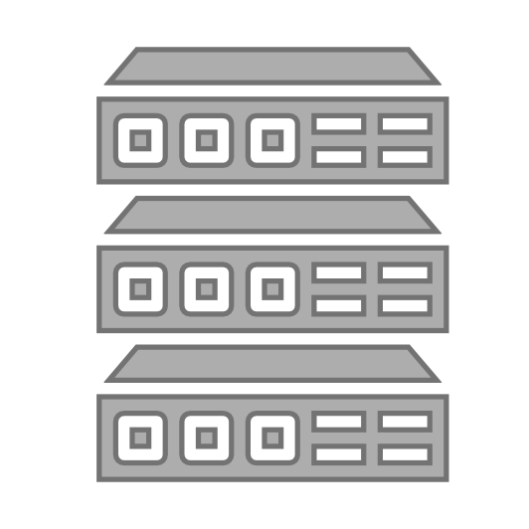


API Management
Discover
Learn
Get access
Try
Get help
SDKs and samples
1st and 3rd party apps
Abstract
Secure & protect
Manage lifecycle
Monitor & measure
Onboard developers
Monetize
Consume
Mediate
Publish
Developer portal
Gateway
Azure portal
App developers
API managers and developers
APIs hosted on and outside of Azure

Slide 17
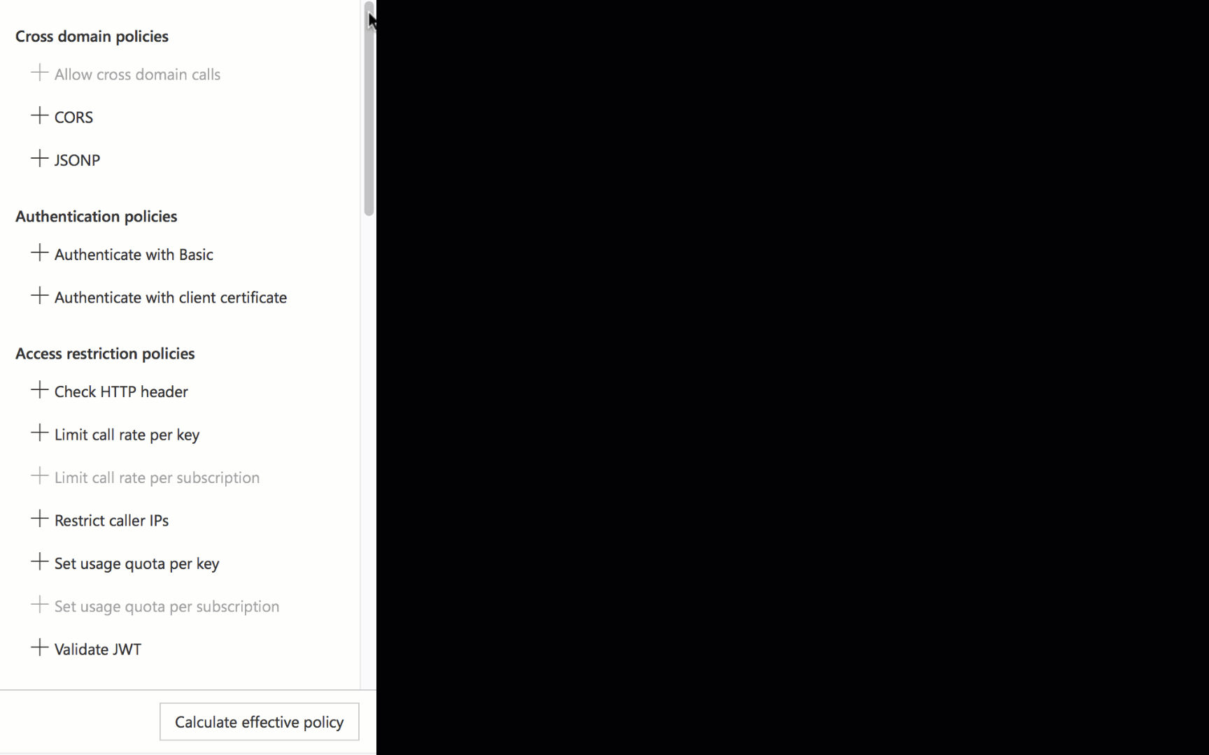
There is a policy for that
Encapsulate common API management functions
Access control, Protection, Transformation, Caching, …
Mutate request context or change API behavior
Add a header or throttle for example
Set in the inbound and outbound directions
Applied at a variety of scopes or on error
Scope determines which APIs are affected
Can define custom scopes in addition to four available b default
Composed into a pipeline from effective scopes
Degree of control over inheritance of scopes, i.e. <base/> element
Don’t delete <base/> inadvertently
http://aka.ms/apimpolicyexamples

Slide 18
Policy scopes
GET /foo/bar HTTP/1.1
Host: api.constoso.com
Key: 0123456789
global
CORS
LOG
0123456789
product
from caller
RATE
QUOTA
inbound
to backend
/foo
api
JWT
/bar
operation
CACHE
URL
BODY
to caller
from backend
outbound

Slide 19
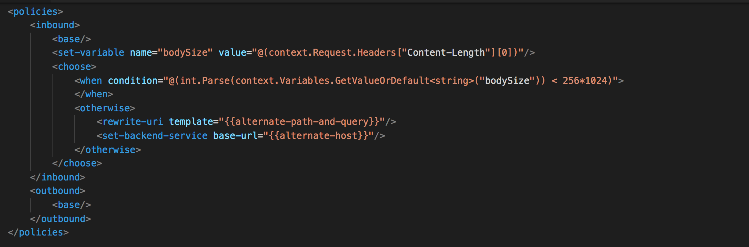
Policy expressions
Named values
C# “snippets” used with policies
Read-only access to the request context
Can use whitelisted .NET types
Dynamically configure and conditionally execute policies
Shared across APIM instance
Keep secrets and “magic” strings out of policies
Add semantics, if named well
Enable a single point of change
Provide environment-specific values

Slide 20
Use Revisions when
You make a non-breaking change to your API
You want to make changes safely
You may want to roll-back your changes
You want to give your developer community details of your changes

Slide 21
Use Versions when
You need to show developers a relationship between APIs
You need to give developers a predictable way to switch between related APIs
You want to add breaking changes
You want to try out changes and solicit feedback from your community

Slide 22



Security and protection
Username/Password
Internet IPs
Microsoft account
Google account
Facebook account
Twitter account
Delegated (custom)
Azure AD
Azure AD B2C
Developer portal
App developers
Consume
Key
OAuth 2 & OpenID Connect
Client certificate
Custom external authorizer
IP filter
Rate limits and quotas
Gateway
HTTP Basic
Mutual certificate
Shared secret
IP filter
VNET/NSG
Mediate
1st and 3rd party apps
Azure portal
Azure account
RBAC
APIs on Azure and outside
Publish
API publishers

Slide 23


VNETs and Hybrid
Developer portal
Consume
App developers
VNET
Gateway
Mediate
1st and 3rd party apps
Azure portal
Publish
APIs on Azure and outside
API managers and developers

Slide 24



VNETs and Hybrid
VPN
VNET
Gateway
Mediate
1st and 3rd party apps

Slide 25


PubSub for two different models
Service Bus
Enterprise Messaging
Event Grid
Reactive Programming
Queue semantics
Rich filters
Instantaneous consistency
Strict ordering
JMS
Geo-Replication & Availability
Rich broker features
Events are raised by other services
Independent individual messages
Push semantics
Filtering and routing
Pay as you go
Fan out

Slide 26

Features of Service Bus
Scheduled delivery
Time To Live
ForwardTo
Defer
Sessions
Batching
Ordering
Auto-delete on idle
OnMessage
Duplicate detection
Filters
Actions
Transactions
Poison message handling

Slide 27
A simple queue
Sender sends message to queue
Queue ACKs receipt
Receiver connects to queue & retrieves message
Receiver ACKs complete (or other action)
Sender
Receiver

Slide 28
Topics & Subscriptions
Sender only knows about Topic
Receivers only know about Subscriptions
Filters and Actions exist on Subscriptions
type=order
Filter
Subscription 1
“type” = “order”
type=quote
Topic
“type” = “quote”
Filter
Subscription 2

Slide 29
Where does Service Bus fit in?
Decoupling and providing durability are primary drivers for using Service Bus
Queue
Frontend / UX
Backend / Processing

Slide 30














Event Grid: Manage all events in one place
IoT Hub
Azure Functions
Blob Storage
Logic Apps
Azure Subscriptions
Azure Automation
Resource Groups
WebHooks
Event Hubs
Event Hubs
Custom Topics
Storage Queues
Azure Media Services
Hybrid Connections
Service Bus

Slide 31


Consistency
Accessibility
Portability
cloudevents.io
Cloud Native Computing Foundation: https://www.cncf.io/

Slide 32

Azure Logic Apps
Automate workflows and orchestrate business processes easily
Out-of-the-box connectors reduce integration challenges
Connect and integrate data from the cloud to on-premises
B2B and enterprise messaging in the cloud
Powerful web-based workflow designer

Slide 33
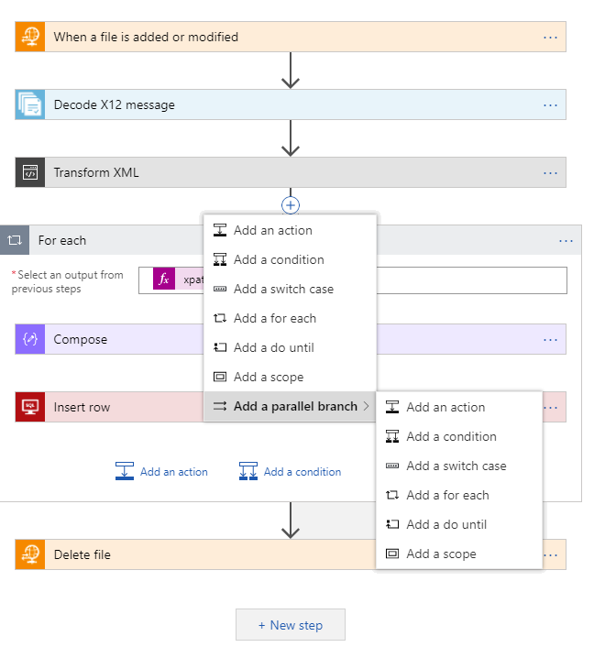
Azure Logic Apps Powerful Capabilities
Fast integration using innovative Visual Designer
Easy workflow creation with triggers and actions
More than 200 connectors to mashup applications, data and services
Built for mission critical 24x7 Enterprise Integration
Devops built-in: Create, deploy, manage and monitor

Slide 34
Platform Flexibility
Messaging
Data Wrangling
B2B & EDI
EAI
(hybrid)
Smart
& SaaS

Slide 35
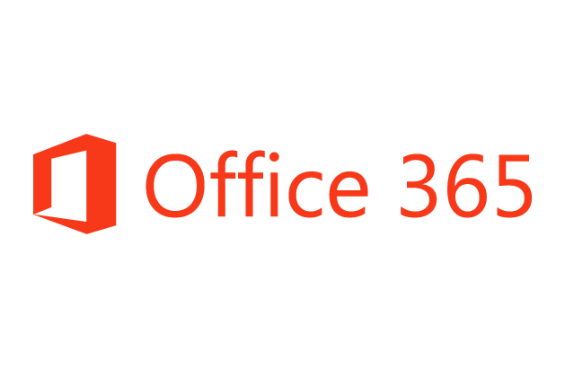













Complete
Machine Learning
Connect on-premises, hybrid and cloud applications
Run mission-critical, complex integration scenarios with ease
Enhance business productivity by automating business processes where it makes sense, on-premises or in Azure
Build “Smart” Integrations leveraging Machine Learning/Cognitive Services
Service Bus
Logic Apps
Cognitive Services
B2B & EDI
API Management
On-premises data gateway
BizTalk Server

Slide 36










Easy Hybrid Integration
On-premises Data Gateway
Azure API
Management
Azure Service Bus
Logic Apps
Logic Apps
Logic Apps
On-premises data gateway for rich data and application integration
Azure API Management for SOAP and backend APIs
Service Bus for cross platform support
GatewayCloud Service
APIM
Azure Service Bus relay
Virtual network or public
Queues
Topics
Gateway
SOAP web services
BackendAPIs
Data Sources
LOB Systems
API-based

Slide 37
Demo: Order Processing

Slide 38
References
API Management: https://aka.ms/azureapim
Service Bus: https://aka.ms/servicebus
Event Grid: https://aka.ms/azureeventgrid
Logic Apps: https://aka.ms/logicapps
Whitepaper: https://aka.ms/integrationpaper
https://aka.ms/socalazure-integration

Slide 39
Thank You!

